Slide 1

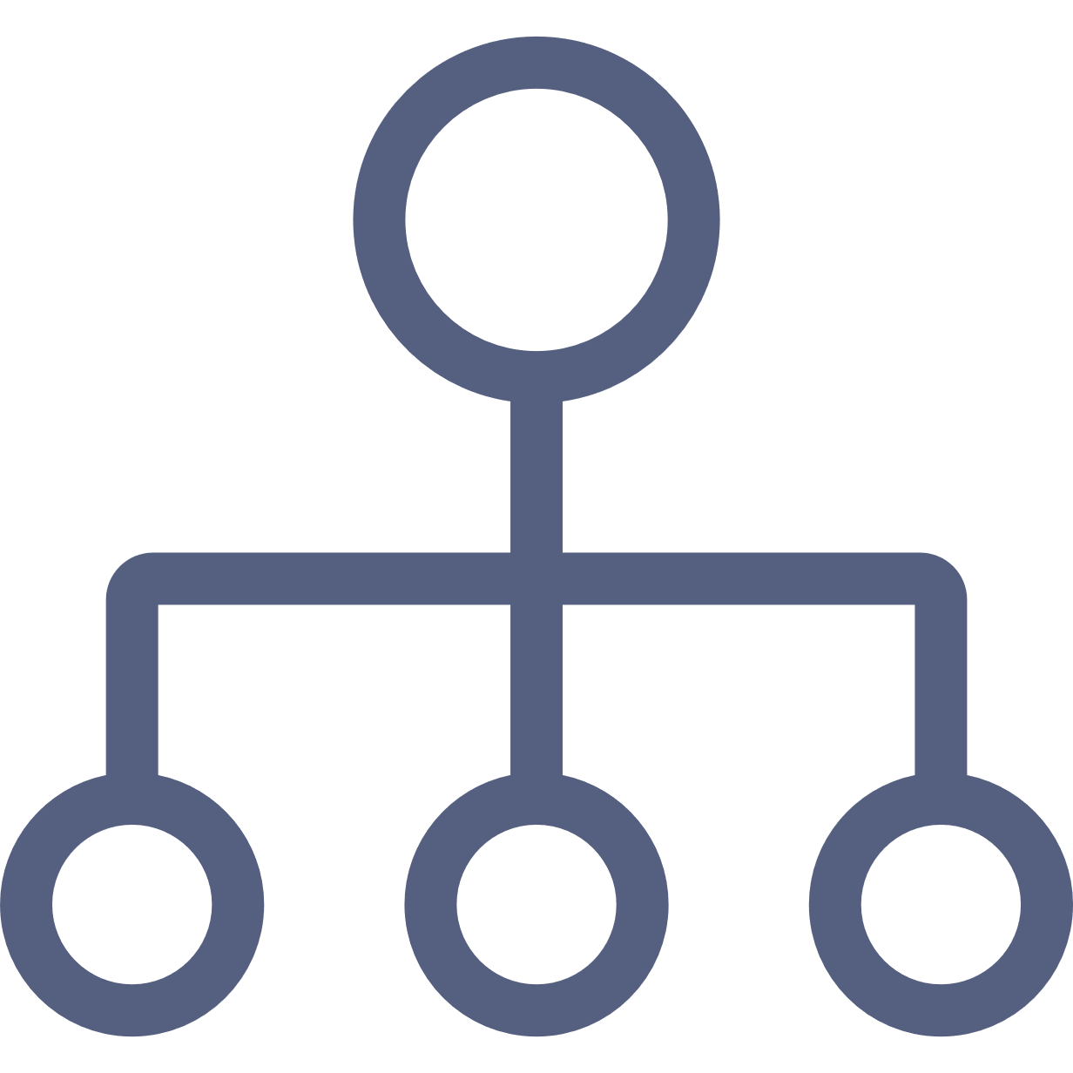




Slide 2






Slide 3
12
CHARACTERISTIC NEEDS
EXCITEMENT
LIBERTY
HARMONY
LOVE
CURIOSITY
PRACTICALITY
IDEAL
STABILITY
CLOSENESS
CHALLENGE
SELF-EXPRESSION
STRUCTURE

Slide 4







SELF-TRANSCENDENCE
HEDOISM
SELF-ENHANCEMENT
VALUES
CONSERVATION
OPEN TO CHANGE

Slide 5
Personality Insights
Watson Discovery

